Slide 1
POLYMERS

Slide 2
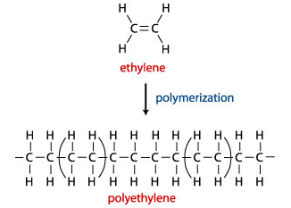
Carbon-based compounds Polymers ARE CHAINS OF Monomers joined together.
A polymer is a macromolecule with high molecular mass ranging from 5000 to one million, which are formed by combination of one or more low molecular weight compound/ s. The unit substance from which polymer is obtained is called monomer.
The process by which polymers are obtained is called polymerization
For e.g. polyethylene is obtained by repeating ethylene unit as a result of polymerization.

Slide 3
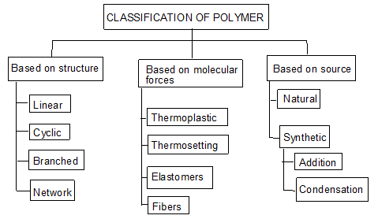
Classification of Polymers
Semi-Synthetic

Slide 4
• Polymers can be separated into plastics and rubbers (fibres not included here) • As engineering materials, it is appropriate to divide them into the following three categories: 1. Thermoplastic polymers 2. Thermosetting polymers 3. Elastomers where (1) and (2) are plastics and (3) are rubbers

Slide 5
Thermoplastic Polymers - Thermoplastics (TP) •Solid materials at room temperature but viscous liquids when heated to temperatures of only a few hundred degrees •This characteristic allows them to be easily and economically shaped into products •They can be subjected to heating and cooling cycles repeatedly without significant degradation

Slide 6
Thermosetting Polymers - Thermosets (TS) •Cannot tolerate repeated heating cycles as thermoplastics can When initially heated, they soften and flow for molding But elevated temperatures also produce a chemical reaction that hardens the material into an infusible solid If reheated, thermosets degrade and char rather than soften

Slide 7
Elastomers: Polymers that exhibit extreme elastic extensibility when subjected to relatively low mechanical stress •Also known as rubber •Some elastomers can be stretched by a factor of 10 and yet completely recover to their original shape •Although their properties are quite different from thermosets, they share a similar molecular structure that is different from the thermoplastics

Slide 8
Examples of Polymers •Thermoplastics: Polyethylene, polyvinylchloride, polypropylene, polystyrene, etc. •Thermosets: Phenolics, epoxides, and certain polyesters •Elastomers: Natural rubber, (vulcanized) Synthetic rubbers, which exceed the tonnage of natural rubber

Slide 9
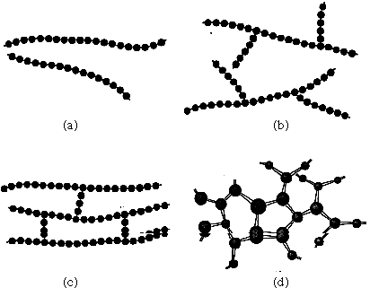
Linear, Branched, and Cross-linked Polymers •Linear structure –chain-like structure Characteristic of thermoplastic polymers •Branched structure –chain-like but with side branches Also found in thermoplastic polymers •Cross-linked structure -Loosely cross-linked, as in an elastomer Tightly cross-linked, as in a thermoset

Slide 10
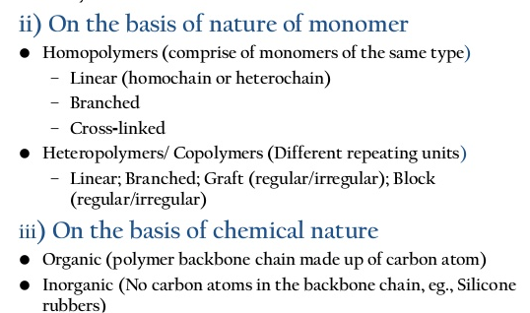

Slide 11
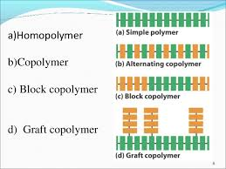

Slide 12
Depending on tacticity:
Isotactic – similar groups on same side of chain
Syndiotactic – two groups alternate
Atatactic – displays no regular pattern
Every other carbon in the chain is a steriocenter
Notes:
Isotactic and Syndiotactic forms are more crystalline in nature and are stronger and more resistant to solvents

Slide 13
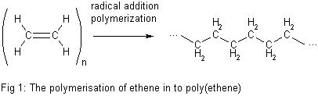
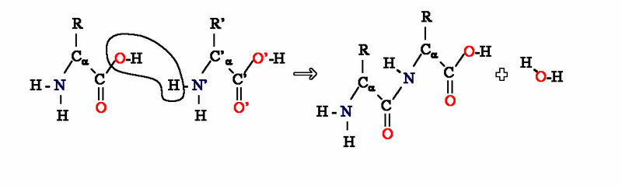
Classification based Polymerization
Addition Polymerization: A polymer formed by direct repeated addition of monomers is called addition polymerization. In this types of polymers monomers are unsaturated compounds or derivatives of alkenes.
Condensation Polymerization: Condensation polymerization involves condensation of two different monomers which are normally bi functional group. During the process there is loss of small molecule such as water

Slide 14
Effect of Branching on Properties •Thermoplastic polymers always possess linear or branched structures, or a mixture of the two
•Branches increase entanglement among the molecules, which makes the polymer: Stronger in the solid state. More viscous at a given temperature in the plastic or liquid state

Slide 15
Effect of Cross-Linking on Properties
•Thermosets possess a high degree of cross-linking, while elastomers possess a low degree of cross-linking
•Thermosets are hard and brittle, while elastomers are elastic and resilient
•Cross-linking causes the polymer to become chemically set The reaction cannot be reversed The polymer structure is permanently changed; if heated, it degrades or burns rather than melt

Slide 16
Mechanical Properties of Thermoplastics
•Low modulus of elasticity (stiffness) E is two or three orders of magnitude lower than metals and ceramics
•Low tensile strength TS is about 10% of the metal
•Much lower hardness than metals or ceramics
•Greater ductility on average Tremendous range of values, from 1% elongation for polystyrene to 500% or more for polypropylene

Slide 17
Physical Properties of Thermoplastics
•Lower densities than metals or ceramics Typical specific gravity for polymers are 1.2 Ceramics specific gravity = 2.5 Metals specific gravity = 7.0
•Much higher coefficient of thermal expansion Roughly five times the value for metals and 10 times the value for ceramics
•Much lower melting temperatures
•Specific heats two to four times those of metals and ceramics
•Thermal conductivities about three orders of magnitude lower than those of metals
•Insulating electrical properties

Slide 18
General Properties and Characteristics of Thermosets
•Rigid - modulus of elasticity is two to three times greater than TP
•Brittle, virtually no ductility
•Less soluble than TP in common solvents
•Capable of higher service temperatures than TP
•Cannot be remelted - instead they degrade or burn

Slide 19
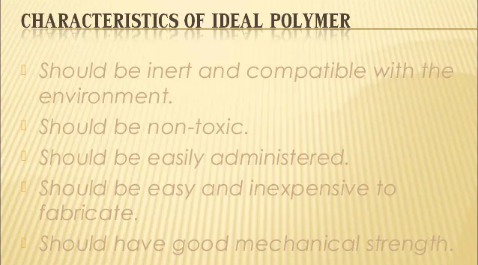

Slide 20
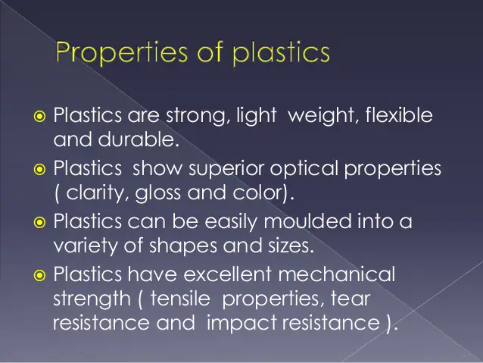
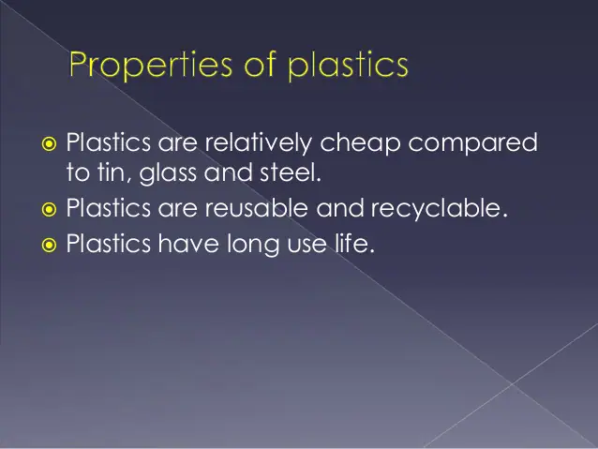
Why are polymers/ plastics extensively used-

Slide 21
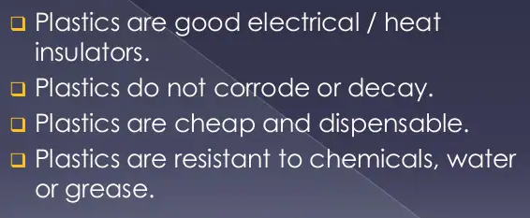

Slide 22
Compounding of polymer
Polymer and Additives
Usually, polymers are mixed with added ingredients (serve a variety of purposes) •Properties of a polymer can often be beneficially changed by combining it with additives
2 types of additives
Modifying additives
Protective additives
Fillers
Reinforcing fillers- to toughen polymers. e.g. carbon black added to rubber; improvement in abrasion resistance
Non-reinforcing fillers- are in powder, added to cheapen the mix (usually these additives do not enhance the properties). e.g. calcium carbonate.
Plasticizer- usually non-volatile liquids, desired to increase the flexibility. e.g. flexible plasticized PVC, eg. Tricresyl phosphate, triphenyl phosphate, etc.
Binders- Hold the constituents together. Eg. Cellulose derivatives. Influence properties of plastics.

Slide 23
Types of Additives by Function
•Resin- main constituent.
Fillers –to strengthen polymer or reduce cost
•Plasticizers –to soften polymer and improve flow
•Colorants –pigments or dyes
•Lubricants –to reduce friction and improve flow, eg. Vegetable oil, soaps, etc.
•Flame retardents –to reduce flammability of plastic
•Cross-linking agents –for thermosets
Stabilizers- Ultraviolet light absorbers –to reduce degradation from sunlight, Antioxidants –to reduce oxidation damage
Pigments- used to colour the product, eg. Titanium oxide- white color, iron oxide red color, etc.
Catalyst- accelearate polymerisation, eg. H2O2, benzoyl peroxide, etc.

Slide 24
Molding or moulding is the process of manufacturing by shaping liquid or pliable raw material using a rigid frame called a mold or matrix. This itself may have been made using a pattern or model of the final object. A mold or mould is a hollowed-out block that is filled with a liquid or pliable material like plastic, glass, metal, or ceramic raw materials. The liquid hardens or sets inside the mold, adopting its shape. A mold is the counterpart to a cast. The very common bi-valve molding process uses two molds, one for each half of the object.
Fabrication/ Moulding

Slide 25
Compression Molding is a process in which a molding polymer is squeezed into a preheated mold taking a shape of the mold cavity and performing curing due to heat and pressure applied to the material.
The method is used mostly for molding thermosetting resins (thermosets), but some thermoplastic parts may also be produced by Compression Molding.
The method uses a split mold mounted in a hydraulic press

Slide 26
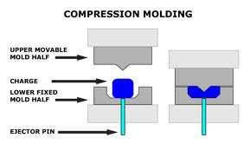
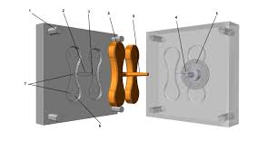
Thermoplastic and thermosets
https://www.youtube.com/watch?v=GqE93pbV_9I

Slide 27
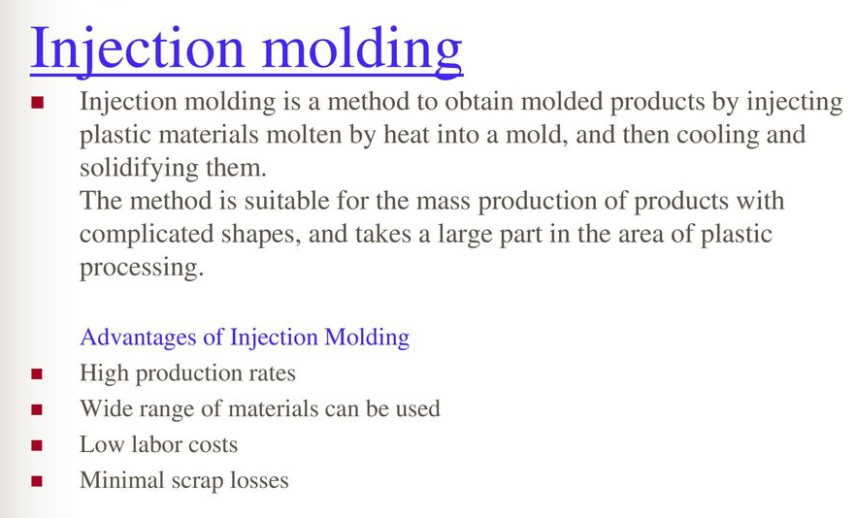

Slide 28
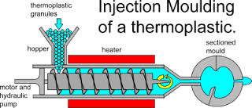
Thermoplastic
https://www.youtube.com/watch?v=b1U9W4iNDiQ

Slide 29
Transfer Molding
The method is used primarily for molding thermosetting resins (thermosets), but some thermoplastic parts may also be produced by Transfer Molding
The method combines features of both Compression Molding (hydraulic pressing and the same molding materials - thermosets) and Injection Molding (ram-plunger and filling the mold through a sprcue).
TS charge is loaded into a chamber immediately ahead of mold cavity, where it is heated; pressure is then applied to force soft polymer to flow into heated mold where it cures
Two variants:
Pot transfer molding - charge is injected from a "pot" through a vertical sprue channel into cavity
Plunger transfer molding – plunger injects charge from a heated well through channels into cavity.

Slide 30
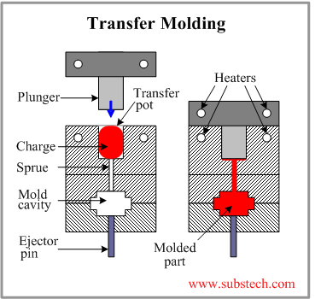
Thermosets
https://www.youtube.com/watch?v=Lp7go_TMe28

Slide 31
Extrusion Molding-
Thermoplastic granules are fed from a hopper by a rotating screw through a heated cylinder.
The tapered shape of the screw compacts the plastic as it becomes plasticized. This part of the process is similar to the heating and compacting stages in the injection moulding process. The difference being that the softened material is allowed to flow out through a die in a continuous stream
( Extrusion moulding ) rather than be pumped intermittently in measured amounts into a mould.( Injection moulding )
The die which is fitted to the end of the extruder barrel determines the cross-section of the extrusion.

Slide 32
Widely used for thermoplastics and elastomers to mass produce items such as tubing, pipes, hose, structural shapes, sheet and film, continuous filaments, and coated electrical wire
Carried out as a continuous process; extrudate is then cut into desired lengths
Extrusion
This process can be compared to squeezing toothpaste from a tube. It is a continuous
process used to produce both solid and hollow products that have a constant
cross-section. E.g. window frames, hose pipe, curtain track, garden trellis.

Slide 33
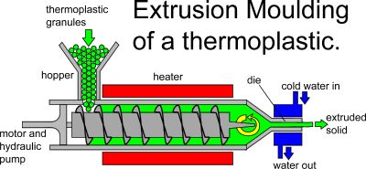
Horizontal
Thermoplastic
https://www.youtube.com/watch?v=Tp2Rdx69SSo

Slide 34
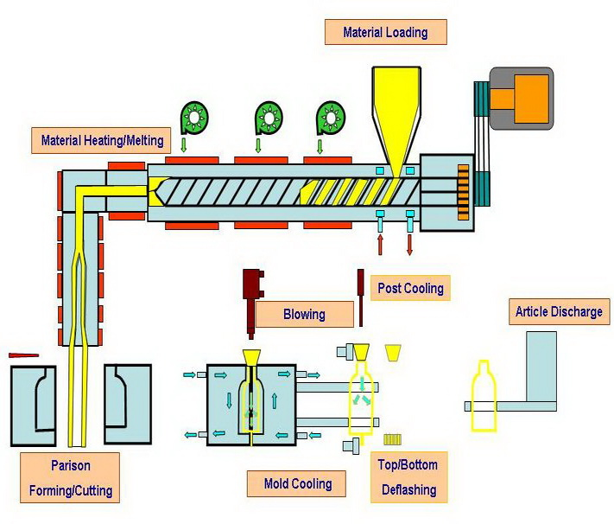
Vertical
Also called as ‘Extrusion Blow Molding’.
https://www.youtube.com/watch?v=xJtyn0vumQU

Slide 35
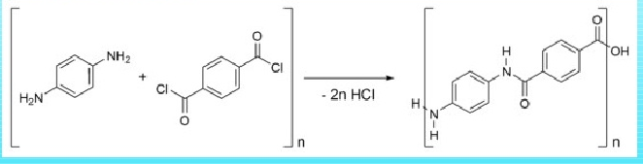
Synthesis of some important polymers-
Kevlar
This is a amide co-polymer synthesized by condensation polymerisation of phenylene diamine and terpthaloyl chloride.
Terepthalic acid is used for manufacture of Kevlar but as terepthaloyl chloride is more active than the terephthalic acid, terepthalic aid is converted to terepthalic chloride which is used to manufacture Kevlar.

Slide 36
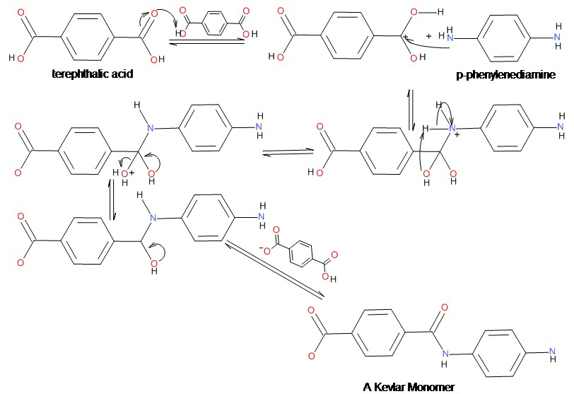
Condensation mechanism-

Slide 37
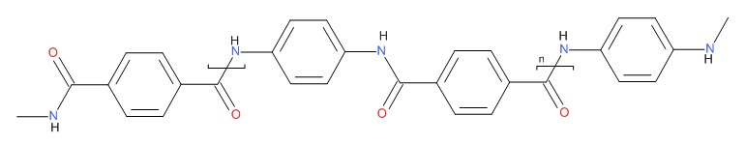
Polymerisation
Kevlar

Slide 38
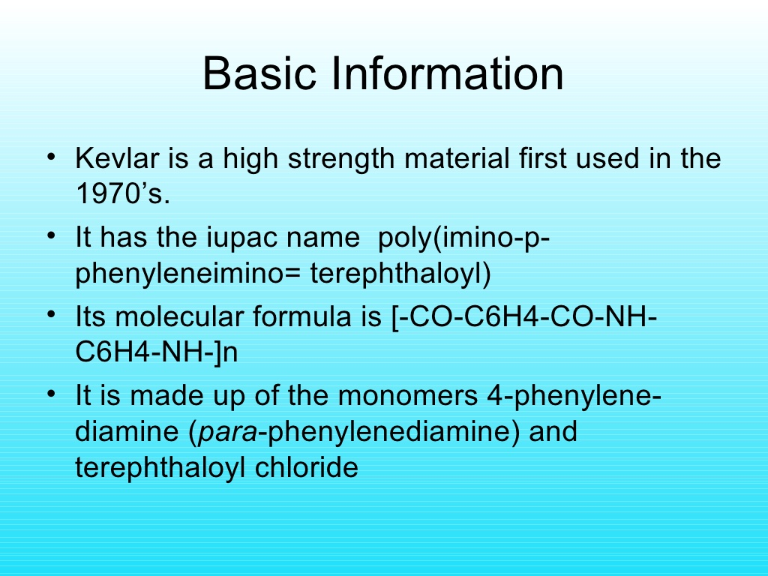
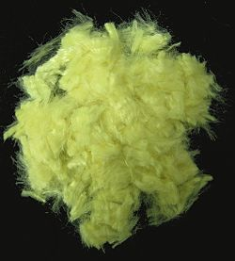
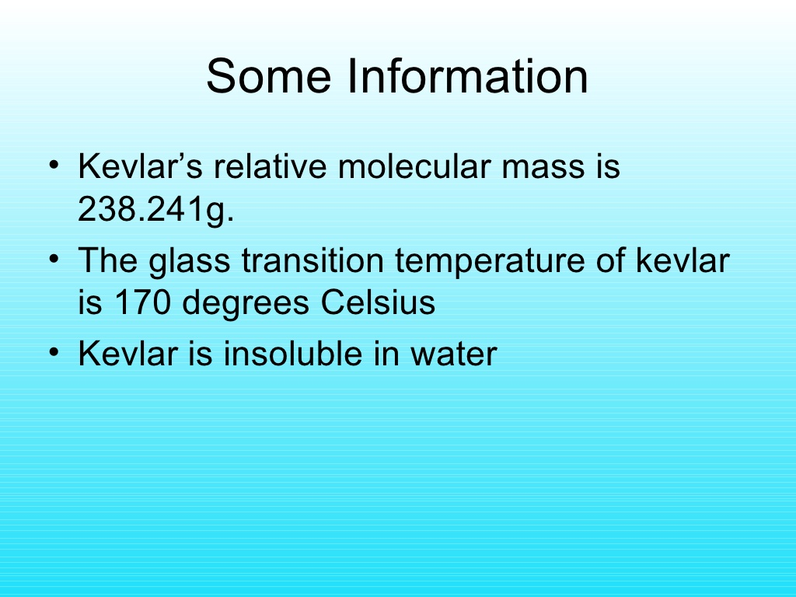

Slide 39
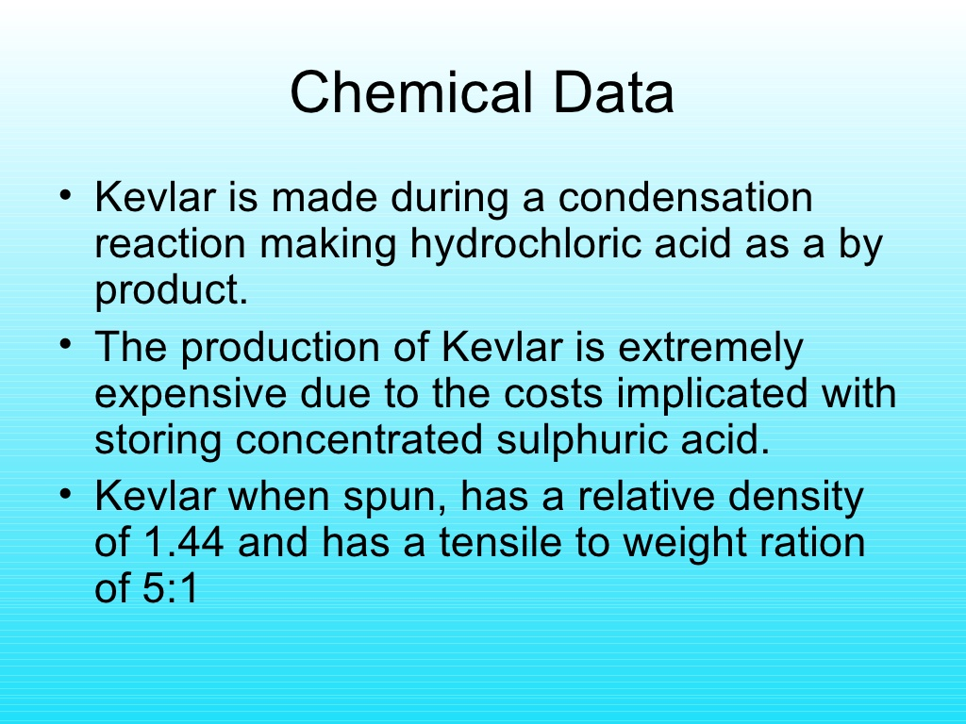

Slide 40
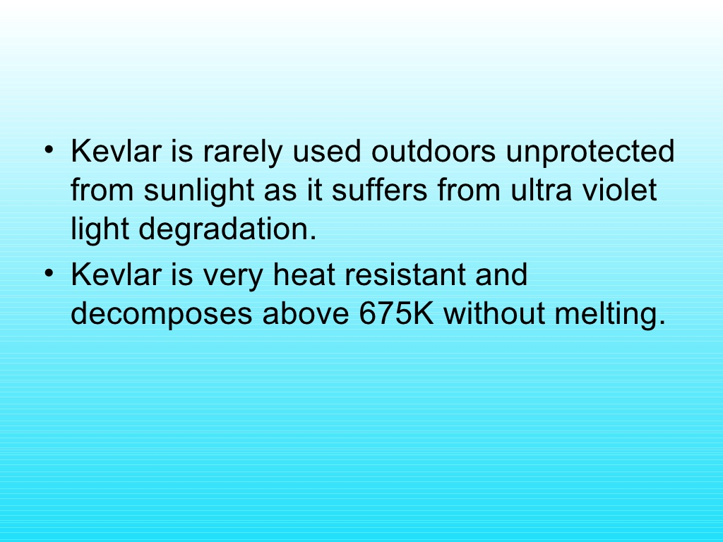
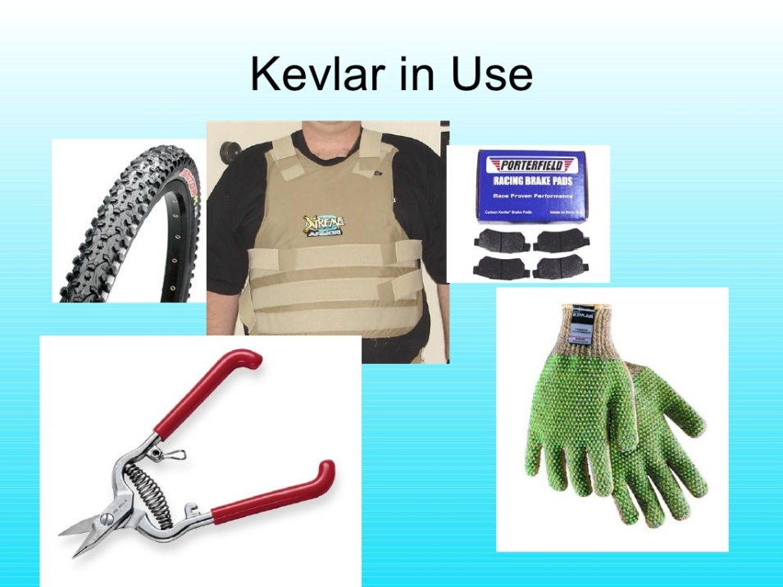

Slide 41
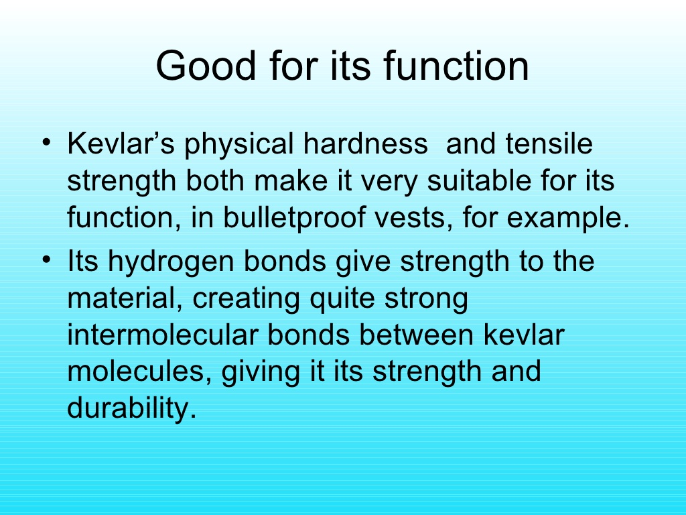

Slide 42
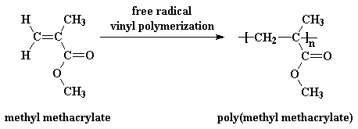
Polymethyl Methacrylate
PMMA is manufactured from Methyl methacrylate by addition poylmerisation (Free Radical Polymerization).

Slide 43
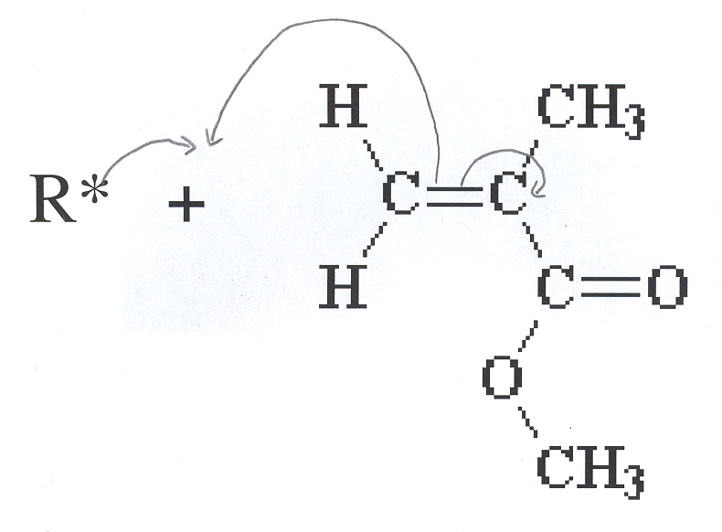
Step 1 : Free radical (R*) plus methyl methacrylate
→

Slide 44
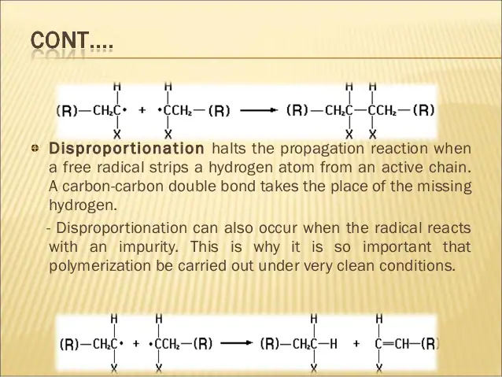
Step 2 : Polymerization - MMA radical plus MMA :repeated many, many times
Step 3 : Termination – occurs when two radicals join
Disproportination
Combination

Slide 45
Catalysts
Multiple catalysts can be used in production of PMMA. Some of these are:
Butyl Lithium
Highly active catalysts based on group 4 metallocenes
An aluminum system supported by salen ligands

Slide 46
Why Use Different Catalysts?
Different catalysts result in different versions of the polymer
Variation is due to the placement of the ester (R-O-R) and methyl (CH₃) groups along the polymer backbone
Isotactic – similar groups on same side of chain
Syndiotactic – two groups alternate
Atatactic – displays no regular pattern
Every other carbon in the chain is a steriocenter

Slide 47
Properties of PMMA
Lighter than glass (density is about half that of glass)
Shatter proof
Softer and easier to scratch than glass (scratch resistant coatings may be applied)
Transmits more light than glass (92% of visible light)
Does not filter UV light (may be coated with UV film)
More transparent than glass, so windows can be made thicker
Current uses for PMMA
Include many uses similar to those for which it was first developed but include many things never imagined by the inventors! A partial list of the uses for PMMA includes:

Slide 48
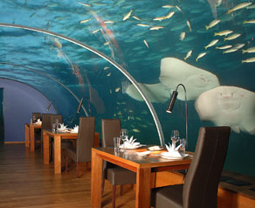
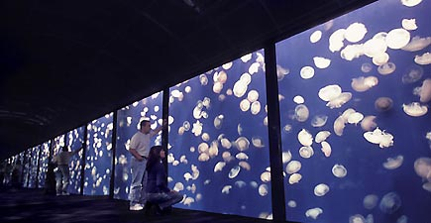
Safety glass such as Plexiglass and Lucite – uses range from windows for aquariums and under-water restaurants to safety shields at hockey rinks to skylights in your home to simple paperweights

Slide 49
Medical Uses
Used as bone cement for use in arthroplastic procedures of the hip, knee, and other joints for the fixation of polymer or metallic prosthetic implants to living bone
Used in Pacemakers
What are characteristics of biomedical polymers?

Slide 50
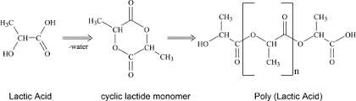
PolyLactic acid (Bio-Degradable Polymer)
Condensation mechanism- Removal of water molecule

Slide 51
Polylactic acid, PLA is a thermoplastic polyester with backbone formula (C₃H₄O₂)_{n} or [–C(CH₃)HC(=O)O–]_{n}, formally obtained by condensation of lactic acid C(CH₃)(OH)HCOOH with loss of water. It can also be prepared by ring-opening polymerization of lactide [–C(CH₃)HC(=O)O–]₂, the cyclic dimer of the basic repeating unit.
The degree of crystallinity, and hence many important properties, is largely controlled by the ratio of D to L enantiomers used.
PLA has become a popular material due to it being economically produced from renewable resources. The monomer is typically made from fermented plant starch such as from corn, cassava, sugarcane or sugar beet pulp.
In 2010, PLA had the second highest consumption volume of any bioplastic of the world. Its widespread application has been hindered by numerous physical and processing shortcomings. PLA is the most widely used plastic filament material in 3D printing.

Slide 52
Properties-
PLA polymers range from amorphous glassy polymer to semi-crystalline and highly crystalline polymer with a glass transition 60–65 °C, a melting temperature 130-180 °C, and a Young's modulus 2.7–16 GPa.
Heat-resistant PLA can withstand temperatures of 110 °C.
Several technologies such as annealing, adding nucleating agents, forming composites with fibers or nano-particles, chain extending and introducing crosslink structures have been used to enhance the mechanical properties of PLA polymers. Polylactic acid can be processed like most thermoplastics into fiber and film.
The high surface energy of PLA results in good printability, making it widely used in 3D printing. PLA is used as a feedstock material in desktop fused filament fabrication by 3D printers, such as RepRap printers. PLA objects can be fabricated by 3D printing, casting, injection moulding, extrusion, machining, and solvent welding.
PLA is soluble in a range of organic solvents like ethyl acetate. PLA is also soluble in hot benzene, tetrahydrofuran, and dioxane.
PLA can be solvent welded using dichloromethane. Acetone also softens the surface of PLA, making it sticky without dissolving it, for welding to another PLA surface.

Slide 53
Applications-
PLA is used in disposable tableware, cutlery, housings for kitchen appliances and electronics such as laptops and handheld devices, and microwavable trays. (However, PLA is not suitable for microwavable containers because of its low glass transition temperature.
It is used for compost bags, food packaging and loose-fill packaging material that is cast, injection molded, or spun.
In the form of a film, it shrinks upon heating, allowing it to be used in shrink tunnels.
In the form of fibers, it is used for monofilament fishing line and netting.
In the form of non-woven fabrics, it is used for upholstery, disposable garments, awnings, feminine hygiene products, and diapers.
PLA has applications in engineering plastics, where the stereocomplex is blended with a rubber-like polymer such as ABS. Such blends have good form stability and visual transparency, making them useful in low-end packaging applications.
PLA is used for automotive parts such as floor mats, panels, and covers.
PLA is used for vegetation and weed prevention. It is used for sandbags, planting pots, binding tape and ropes.

Slide 54
Applications in the field of Medicine-
PLA can degrade into innocuous lactic acid, so it is used as medical implants in the form of anchors, screws, plates, pins, rods, and mesh.
It breaks down inside the body within 6 months to 2 years. This gradual degradation is desirable for a support structure, because it gradually transfers the load to the body (e.g. to the bone) as that area heals. PLA has high strength characteristics.
Thanks to its bio-compatibility and biodegradability, PLA has also found ample interest as a polymeric scaffold for drug delivery purposes.
The composite blend of various PLA with tricalcium phosphate (TCP) is used as scaffolds for bone engineering.
Poly-L-lactic acid (PLLA) is the main ingredient in Sculptra, a facial volume enhancer used for treating lipoatrophy of the cheeks.
PLLA is used to stimulate collagen synthesis in fibroblasts via foreign body reaction in the presence of macrophages. Macrophages act as a stimulant in secretion of cytokines and mediators such as TGF-β, which stimulate the fibroblast to secrete collagen into the surrounding tissue. Therefore, PLLA has potential applications in the dermatological studies

Slide 55
Degradation-
PLA is degraded abiotically by three mechanisms:^{[42]}
Hydrolysis: The ester groups of the main chain are cleaved, thus reducing molecular weight.
Thermal degradation: A complex phenomenon leading to the appearance of different compounds such as lighter molecules and linear and cyclic oligomers with different Mw, and lactide.
Photodegradation: UV radiation induces degradation. This is a factor mainly where PLA is exposed to sunlight in its applications in plasticulture, packaging containers and films.
PLA is effectively digested in hotter industrial composts, usually degrading best at temperatures of over 60°C.
PLA samples of various molecular weights were degraded into methyl lactate (a green solvent) by using a metal complex catalyst.
PLA can also be degraded by some bacteria, such as Amycolatopsis and Saccharothrix. A purified protease from Amycolatopsis sp., PLA depolymerase, can also degrade PLA. Enzymes such as pronase and most effectively proteinase K from Tritirachium album degrade PLA.

Slide 56

Four possible end-of-life scenarios are the most common:
Recycling: which can be either chemical or mechanical. Currently, the SPI resin identification code 7 ("others") is applicable for PLA.
Composting: PLA is biodegradable under industrial composting conditions, starting with chemical hydrolysis process, followed by microbial digestion, to ultimately degrade the PLA. Under industrial composting conditions (58 °C), PLA can partly (about half) decompose into water and carbon dioxide in 60 days, after which the remainder decomposes much more slowly.
Incineration: PLA can be incinerated without producing chlorine-containing chemicals or heavy metals because it contains only carbon, oxygen, and hydrogen atoms. Since it does not contain chlorine it does not produce dioxins during incineration.
Landfill: the least preferable option is landfilling because PLA degrades very slowly in ambient temperatures, often as slowly as other plastics.

Slide 57
Polymers In Medicine
Cellophane
PGA, PLA, PLGA
Polydimethylsiloxane
Polyethylene and PMMA
Polytetrafluoroethylene
Polyurethane
What are they?
Substances other than food or drugs contained in therapeutic or diagnostic systems that are in contact with tissue or biological fluids.
Why use Biomaterials?
Improve patient’s quality of life by replacing a defective body part with a substitute.
Physicians were limited to use off-the shelf supplies.
Novel biodegradable polymers and modified natural substances.

Slide 58
 | Applications of Biomaterials
Polymer | Applications | Polymer | Applications
PDMS | Catheters, heart | Polytetrafluoroe | Heart valves
 | Valves | thylene | Vascular grafts
 |  |  | Nerve repair
Polyurethane | ventricular assist | Polyethylene | Catheters, hip
 | Devices |  | prostheses
 |  | Polymethylmetha | Fracture fixation
PGA, PLA, | Drug delivery, devices | crylate (PMMA)
And PLGA
 |  | Cellophane | Dialysis
 |  |  | membranes

Slide 59
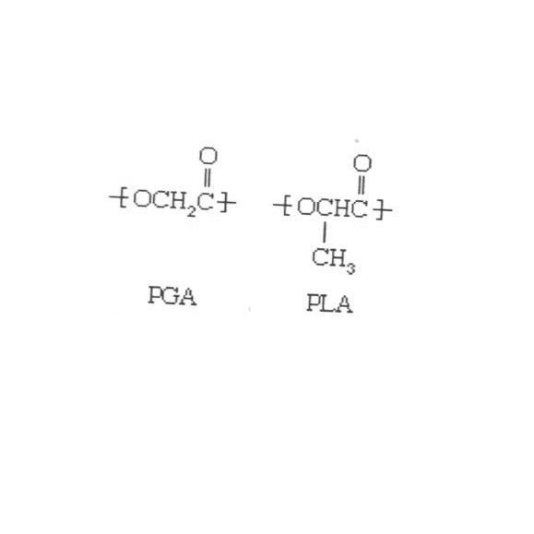
Polylactic acid, Polyglycolic cid
Amorphous forms used in drug delivery systems
Crystalline forms good for scaffolding, or sutures; stents, plastic surgery, plates rods, pins, screws.
Two essentials in scaffolding: high surface to volume ratio, highly porous
-Allows cells to easily proliferate for setup of pathways
-Setup of pathways for nutrients

Slide 60
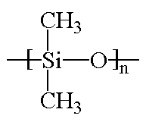
Polydimethylsiloxane
“Silicon”
Lubricants and Foaming agents
Pacemakers and Vaccine Delivery systems

Slide 61
Used in treatment of prostate carcinoma
Small biodegradable pellets (188 m) injected into area of body where needed; heart valves, blood filters, vascular tubing, artificial heart.
Smaller doses, less toxic effects for patient

Slide 62
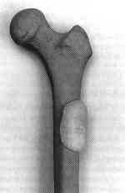
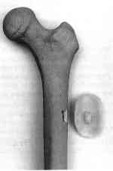
PMMA
Thermoplastics, exhibit moderate to high tensile strength with moderate elongation
Used for Hip replacement and Fracture Fixation
Annual procedures approaching 5 Million
Metal alternatives have corrosive problems
PMMA disc over femoral window during the molding process
PMMA template after polymerization, showing molded plug

Slide 63
Intrinsically conducting polymers (ICPs) belong to a class of organic materials with unique electronic properties such as electric conductivity, electrochromism, and electroactivity. Conjugated electrons in the backbone of their macromolecules are responsible for these properties. Due to their high electrical properties, ICPs are intensively investigated for application in electronics, microelectronics, optoelectronics mainly for areas in aerospace and automobile industries. Among the most promising applications of the ICPs are corrosion protection, solid-state charge storage devices, electromagnetic screens, antistatic coatings and gas separation coatings. However, poor mechanical properties, environmental sensitivity, moderate stability of electrical properties with temperature significantly limit the industrial applicability of ICPs.
Conducting polymers

Slide 64
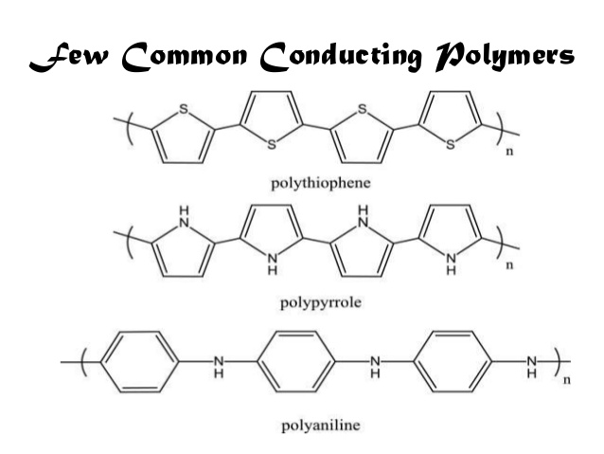
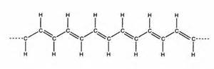
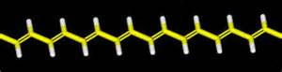
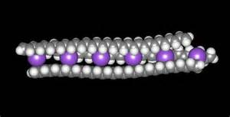
Polyacetylene

Slide 65
(DCP) Doped conducting polymer
While the addition of a donor or an acceptor molecule to the polymer is called "doping ", the reaction that takes place is actually a redox reaction. • The first step is the formation of a cation (or anion) radical, which is called a soliton or a polaron.
Pn ⇔ [Pn + A – ] (reduction oxidation)
• As synthesized conductive polymers exhibit very low conductivities. It is not until an electron is removed from the valence band (p-doping) or added to the conduction band (n-doping, which is far less common) does a conducting polymer become highly conductive. • Doping (p or n) generates charge carriers which move in an electric field. Positive charges (holes) and negative charges (electrons) move to opposite electrodes. This movement of charge is what is actually responsible for electrical conductivity.

Slide 66
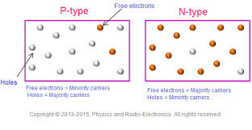
Oxidation process (p–doping):
(C₂H₂)_{n} + FeCl₃ → (C₂H₂⁺)_{n}.FeCl₄ + FeCl₂
Polyacetylene lewis acid +vely charged backbone
2(C₂H₂)_{n +} 3I₂ → 2[(C₂H₂⁺)_{n}I₃⁻]
Reduction process (n-doping):
(C₂H₂)_{n} + C₁₀H₇NH₂ → [(C₂H₂⁻)_{n}NH⁺] + C₁₀H₈
Polyacetylene Naphthylamine reduction -vly charged backbone naphthalene
The above reactions are most likely to occur saturated polym electrons, as they can be very easily removed from the polymeric chains to form polyion therefore, these are the types of polymers, which assume high conductivity on doping.

Slide 67
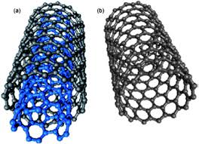
ECP
One type of extrinsically conducting polymer consists of a matrix of poly(ethene) with a percentage of conducting carbon black (a form of powdered graphite) incorporated (filled) in it. If the carbon black particles are close enough to be in contact with one another, the material conducts. If the particles are not in contact, it is an insulator. This means that the degree of electrical conduction depends on temperature. At high temperature, the poly(ethene) matrix expands and pulls the particles of carbon black away from each other, decreasing the conductivity. At lower temperatures the poly(ethene) contracts, the carbon black particles are closer and the material conducts well. This temperature dependence of conductivity leads to the use of this material in self-regulating heater cable and PolySwitch* re-settable circuit protection devices.

Slide 68
Another type includes the blends Extrinsically conductive polymers can involve a blend of conductive and nonconductive polymers.
Co-ordinate Conjugate Polymers (CCP)-
A coordination polymer is an inorganic or organometallic polymer structure containing metal cation centers linked by organic ligands. More formally a coordination polymer is a coordination compound with repeating coordination entities extending in 1, 2, or 3 dimensions.
It can also be described as a polymer whose repeat units are coordination complexes. Coordination polymers contain the subclass coordination networks that are coordination compounds extending, through repeating coordination entities, in 1 dimension, but with cross-links between two or more individual chains, loops, or spiro-links, or a coordination compound extending through repeating coordination entities in 2 or 3 dimensions. A subclass of these are the metal-organic frameworks, or MOFs, that are coordination networks with organic ligands containing potential voids.

Slide 69
Coordination polymers are relevant to many fields such as organic and inorganic chemistry, biochemistry, materials science, electrochemistry, and pharmacology, having many potential applications. This interdisciplinary nature has led to extensive study in the past few decades.
Coordination polymers can be classified in a number of different ways according to their structure and composition. One important classification is referred to as dimensionality.

Slide 70
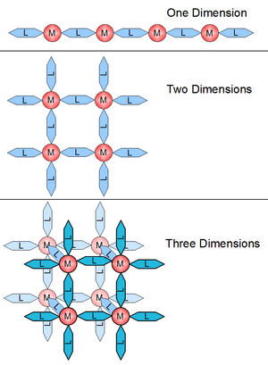
A structure can be determined to be one-, two- or three-dimensional, depending on the number of directions in space the array extends in. A one-dimensional structure extends in a straight line (along the x axis); a two-dimensional structure extends in a plane (two directions, x and y axes); and a three-dimensional structure extends in all three directions (x, y, and z axes). This is depicted in Figure

Slide 71
In most coordination polymers, a ligand (atom or group of atoms) will formally donate a lone pair of electrons to a metal cation and form a coordination complex via a Lewis acid/ base relationship (Lewis acids and bases). Coordination polymers are formed when a ligand has the ability to form multiple coordination bonds and act as a bridge between multiple metal centers.

Slide 72
Polymers in industry
Type
Abbreviation
Typical Uses
Phenol-formaldehyde
Urea-formaldehyde
Unsaturated polyester
Epoxy
Melamine-formaldehyde
PF
UF
UP
-
MF
Electrical and electronic equipment,
automobile parts, utensil handles,
plywood adhesives, particle board
binder
Similar to PF polymer; also
treatment of textiles, coatings
Construction, automobile parts, boat
hulls, marine accessories,
corrosion-resistant ducting, pipe,
tanks, etc., business equipment
Protective coatings, adhesives,
electrical and electronics
applications, industrial flooring
highway paving materials,
composites
Similar to UF polymers; decorative
panels, counter and table tops,
dinnerware

Slide 73
Polymer Molecular weight and its Measurement methods
There are several reasons why we might want to measure polymer average molecular weight and its distribution:
The molecular weight and its distribution determine the viscous and elastic properties of the molten polymer. This affects the processibility of the melt and also the behavior of the resulting solid material. For example, a resin suitable for extrusion must have a high viscosity at low shear rates so that the extrudate maintains its integrity. To be suitable for injection molding, however, the same resin must have a low viscosity at high shear rates so that the injection pressure not be excessive.
The molecular weight of a polymer can determine its applications. For example, the resin used for making polycarbonate water bottles differs significantly in molecular weight from the polycarbonate that goes into compact disks.
Differences in molecular weight distribution also influence the polymer properties. As a consequence, two chemically similar polymers, processed identically, that have the same molecular weight but different molecular-weight distributions may result in products that show significantly different shrinkages, tensile properties, and failure properties. For this very important reason, it is advantageous to know the molecular weight and molecular-weight distribution of the polymers used.
Other situations where the molecular weight and its distribution directly influence results include phase equilibrium and crystallization kinetics.

Slide 74
M.wt Measurement Methods
Number average M.wt
Viscosity average M.wt
END-GROUP ANALYSIS
COLLIGATIVE PROPERTIES
Viscometry
Weight average M.wt
Light Scattering
Z-average M.wt
Ultracentrifugation
Gel Permeation Chromatography (GPC)
NOTE: The choice of method for polymer molecular weight determination is influenced by factors such as: (i) information required, (ii) operative region, (iii) cost effectiveness, and (iv) experimental conditions and requirements.

Slide 75
Molecular Weight:
Molecular weight of a chemical compound can be defined, simply, as the sum of the atomic weights of each of the atoms in the molecule.
Examples:
Water (H₂O) is 2 H (1g) and one O (16g) = 2*(1) + 1*(16)= 18 g/mol Methane CH₄ is 1 C (12g) and 4 H (1g)= 1*(12) + 4 *(1) = 16 g/mole Polyethylene -(C₂H₄)-₁₀₀₀ = 2 C (12g) + 4H (1g) = 28g/mole * 1000 = 28,000 g/mole
Average Molecular Weight
Polymers are made up of many molecular weights or a distribution of chain lengths. In other other words, if one takes polyethylene as an example, this polymer may have chains of ethylene (C₂H₄) with different lengths; some longer than others.
Example:
Polyethylene -(C₂H₄)-₁₀₀₀ has some chains with 1001 repeating ethylene units, some with 1010 ethylene units, some with 999 repeating units, and some with 990 repeating units. The average number of repeating units or chain length is 1000 repeating ethylene units for a molecular weight of 28*1000 or 28,000 g/mole .
Therefore, polymers must be represented by the value of average molecular weight.

Slide 76
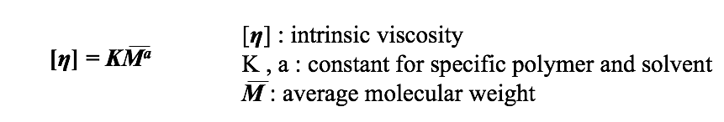
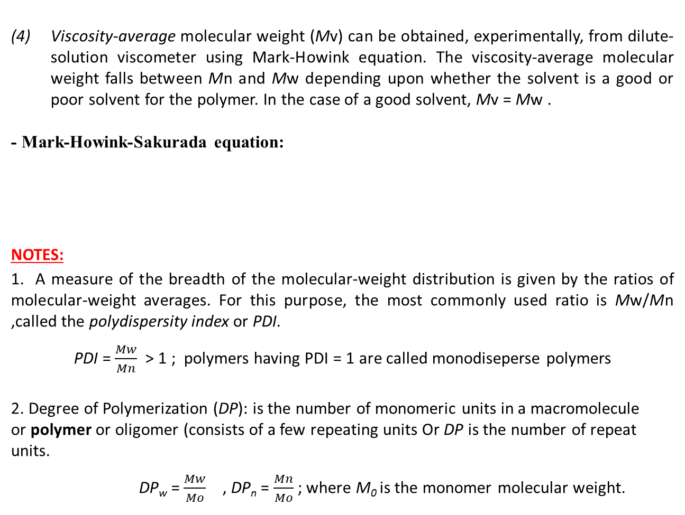
Viscosity-average molecular weight (Mv) can be obtained, experimentally, from dilute-solution viscometer using Mark-Howink equation. The viscosity-average molecular weight falls between Mn and Mw depending upon whether the solvent is a good or poor solvent for the polymer. In the case of a good solvent, Mv = Mw .
- Mark-Howink-Sakurada equation:
NOTES:
1. A measure of the breadth of the molecular-weight distribution is given by the ratios of molecular-weight averages. For this purpose, the most commonly used ratio is Mw/Mn ,called the polydispersity index or PDI.
PDI = $\frac{Mw}{Mn}$ > 1 ; polymers having PDI = 1 are called monodiseperse polymers
2. Degree of Polymerization (DP): is the number of monomeric units in a macromolecule or polymer or oligomer (consists of a few repeating units Or DP is the number of repeat units.
DP_{w} = $\frac{Mw}{Mo}$ , DP_{n} = $\frac{Mn}{Mo}$ ; where M₀ is the monomer molecular weight.

Slide 77
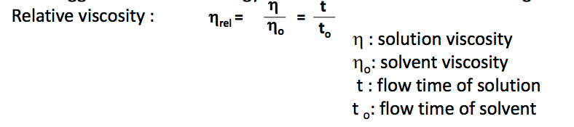
Viscometry
A method that is widely use for routine molecular-weight determination is based on the determination of intrinsic viscosity, η, of a polymer in solution through measurements of solution viscosity.
The fundamental relationship between η and molecular-weight is given in Mark-Howink equation (mentioned in Page 6):
It is clear in the above equation that the value of intrinsic viscosity of the diluted polymer is needed to determine the molecular weight. To find the intrinsic viscosity, a series of experimental measurements and calculations have to be made. These steps are as follows:
1. The relative viscosity can be measured experimentally using a suitable viscometer:

Slide 78
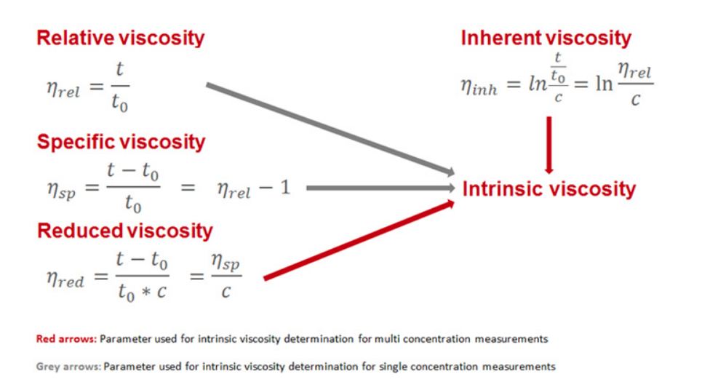
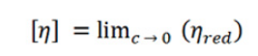

2. The intrinsic viscosity can be calculated as shown below:

Slide 79

Intrinsic Viscosity
Fig. 1 Reduced viscosity and inherent viscosity of nylon 66 in 90% formic acid (Adapted from Ph.D thesis of R Walia, P. S., Chemical Engineering, West Virginia University, Morgantown, 1998).

